Slide 1

JAYOTI VIDYAPEETH WOMEN’S UNIVERSITY ,JAIPUR
INTERNATIONAL CONFERENCE
ON
“recent engineering trends in community development &
women’s participation
Etcdwp-2019
TOPIC-THE IDENTIFICATION EMAIL SYSTEM TECHNOLOGY
JV ‘n Jagriti Rastogi

Slide 2
OUTLINE OF PRESENTATION
Introduction
History of email technology
Uses of email
Structure of email
Conclusion

Slide 3
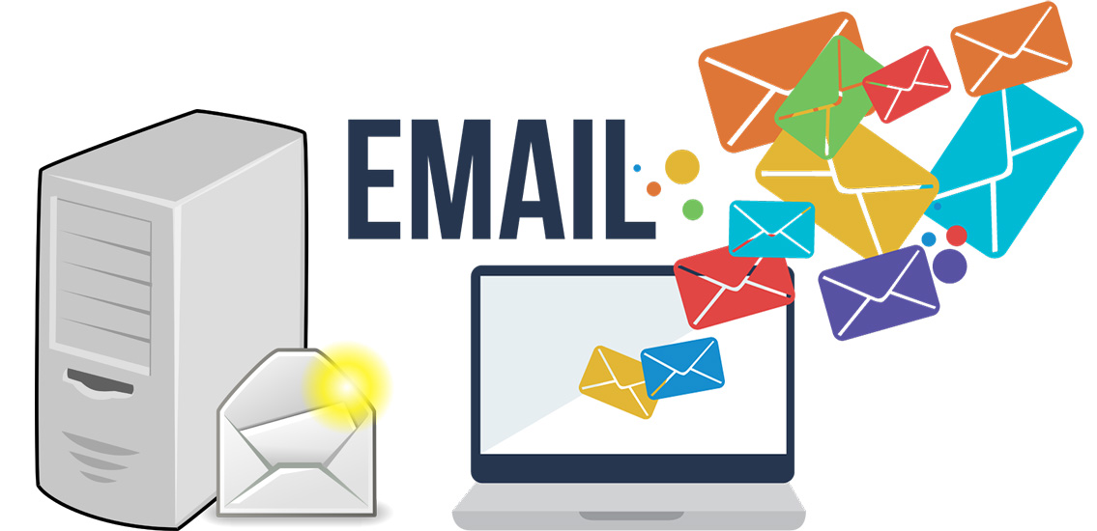

Slide 4
What is email technology
Electronic mail, often abbreviate as email, is a method of exchanging digital messages designed primarily for human use.
Email system are based on a store & forward model in which Email server systems accept, forward, deliver and stored messages on the behalf of users, who only need to connect to the infrastructure.

Slide 5
HISTORY OF EMAIL TECHNOLOGY
The foundation for today’s global internet email service was created in the early ARPAnet.
Standards for encoding of messages were proposed as early as, for example, in 1973(RFC561).
An email send in the early 1970s looked very similar to one sent on the internet today.
Network-based email was initially on the ARPAnet in the extensions to the (FTP), but is today carried by the (SMTP)

Slide 6
Why to use email
We can send a message anytime anywhere .
We can send the same message to several peoples at sometime.
We can forward the information to co-workers without retyping it.
We can the messages around the world as easily as to friend in the next cabin.
We can save the time, email is very fast, usually taking no more time then a few minutes to be received.
We can mail electronic documents and recipients can then edit and return revised version.
It is very fast as compare to postal mail.

Slide 7
Structure of email technology
An electronic mail consist of two component
Message header: the message header contains control information, including an originator’s email address and one or more recipient addresses. Usually additional information is added, such as subject header file.
Message body: which is the email content.

Slide 8
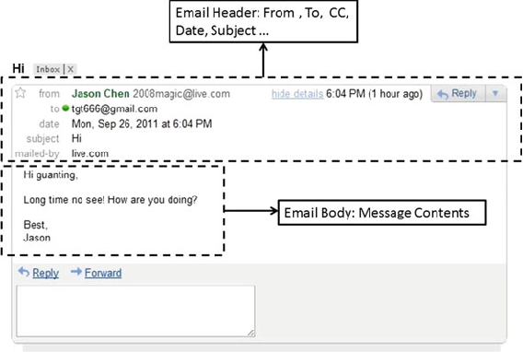
Structure of email technology

Slide 9
HEADER FIELD
The message header should include at least the following field
From: the email addresses and optionally the name of the author or sender
To: the email address of the message’s recipients. Indicates primary recipients, for secondary recipients see cc and bcc.
Bcc(blind carbon copy): addresses added to the smtp delivery list but not (usually) listed in the message data, remaining invisible to other recipients.
Cc(carbon copy): many email clients will mark email in your inbox differently depending on whether you are in the to: or cc: list

Slide 10
Email address
To deliver mail, a system must use an addressing system with unique addresses
Address consist of two parts:
Local part
Domain name
These are separated by @sign.

Slide 11
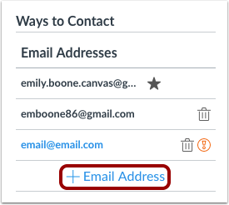
Email address

Slide 12
Email address
Like a postal address, an email address specifies the destination of an electronic message.
An internet email address looks like this: user name @ domain name
The user name is a unique name that identifies the recipient. The domain name is the address many people can share the same domain name.

Slide 13
conclusion
E-mail is familiar to most students and workers. It may be used like text, or synchronous chat, and it can be delivered to a cell phone. In business, email has largely replaced print hard copy letters for external (outside the company) correspondence, and in many cases, it has taken the place of memos for internal (within the company) communication. e-mail can be very useful for messages that have slightly more content than a text message, but it is still best used for fairly brief messages. Many businesses use automated e-mails to acknowledge communications from the public, or to remind associates that periodic reports or payments are due. You may also be assigned to “populate” a form e-mail in which standard paragraphs are used, but you choose from a menu of sentences to make the wording suitable for a particular transaction.

